Slide 1
3-D Detection and Jewelry
Sprint 3
A1_Group #3 on0007@bu.edu
Orif Negmatov

Slide 2



1. Product mission
For the jewelry item customers, who need a verification process to make sure the product they purchase is authentic.

Slide 3
2. Minimum Value Product (MVP)
Mobile application that scans and recognizes jewelry items
The app receives an image as Input
And will speak out the properties of the item

Slide 4
3. Literature Review
Initial thoughts:
Machine learning tools might be useful
Optical Spectroscopy
Final thoughts:
Nyris = Object Detection API
Why use Nyris?
Nyris has Visual search API
It provides the most similar products
Privacy Shield Framework
an agreement between the EU and US
Notes:
What is ARKit? ARkit stands for Augmented Reality Kit, a development platform that enables app developers to build AR experiences quickly and easily into their apps and games. It utilizes your iOS device's camera, processors, and motion sensors to create some immersive interactions. For example, one could preview Ikea products in his or her own home before making a purchase and look at the product from all the angles needed. With the aid of AR, it is even possible to measure the Ikea furniture dimensions and test the product virtually whether a chair or couch fits in the living room or a bed fits in the bedroom.
In the second example, which is Interior decoration project, multiple users with different devices are able to see the same AR environment. All users can contribute to the Interior decoration project from their own devices.
Spectroscopy is used as a tool for studying the structures of atoms and molecules. The large number of wavelengths emitted by these systems makes it possible to investigate their structures in detail, including the electron configurations of ground and various excited states.

Slide 5
3. Visual search vs Text search engine
Image vs Keyword
Nyris provides solution to both:
It can detect objects via image, keyword, or barcode
Notes:
What is ARKit? ARkit stands for Augmented Reality Kit, a development platform that enables app developers to build AR experiences quickly and easily into their apps and games. It utilizes your iOS device's camera, processors, and motion sensors to create some immersive interactions. For example, one could preview Ikea products in his or her own home before making a purchase and look at the product from all the angles needed. With the aid of AR, it is even possible to measure the Ikea furniture dimensions and test the product virtually whether a chair or couch fits in the living room or a bed fits in the bedroom.
In the second example, which is Interior decoration project, multiple users with different devices are able to see the same AR environment. All users can contribute to the Interior decoration project from their own devices.
Spectroscopy is used as a tool for studying the structures of atoms and molecules. The large number of wavelengths emitted by these systems makes it possible to investigate their structures in detail, including the electron configurations of ground and various excited states.

Slide 6
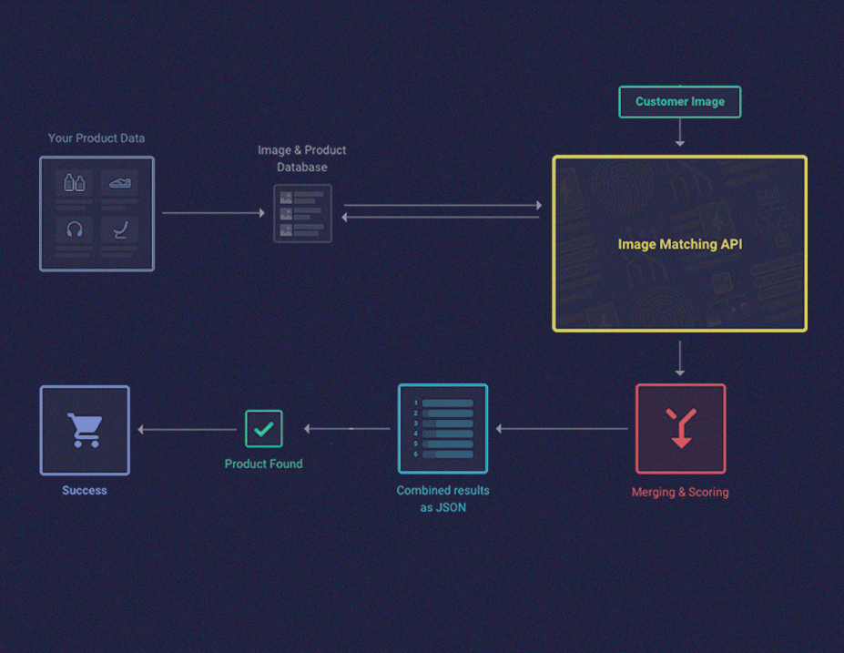
4. Nyris
Nyris capabilities:
Fast
Easy to implement with IOS app
Stores the data of your inventory
Easy to update your products
Note: Nyris is useful for commercial
and retail

Slide 7
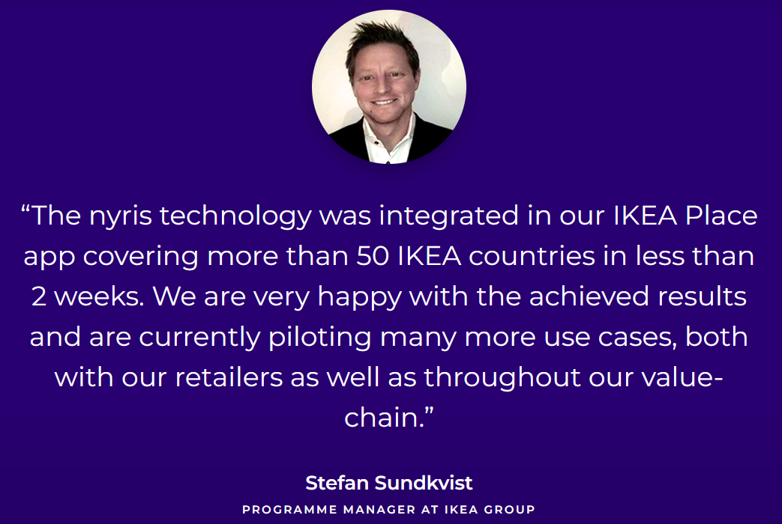
4. Nyris - One successful example, IKEA Place
Time-efficient
Business plan
Implemented in retail
Example to follow

Slide 8
5. Achievements
Xcode and Swift installed in Mac Cloud remote computer
Simplest program “Hello world” works properly
The workspace is setup properly
Learned basic features of creating a mobile app

Slide 9
6. Sprint 4 Goals
Run sample codes of other mobile apps
Decide how to utilize Nyris
Look at Apple’s developer website
Learn to publish the app to Apple Store
- even though the app is still under development

Slide 10
Thanks for listening

Slide 11
References
https://iopscience.iop.org/article/10.1088/1361-6552/aaa0e6/meta?casa_token=hPT73Gj-zlwAAAAA:va7vykNC17OiY3etWrJ9fuzz3Zm11iJJhAvy6dHTJlXiWLtHMKanzNfZqZ1jsfL4A3bnEGWt-kSNvYby9dL2
https://www.researchgate.net/profile/Marek-Woda/publication/333039077_Capabilities_of_ARCore_and_ARKit_Platforms_for_ARVR_Applications/links/5d24e096299bf1547ca75dfe/Capabilities-of-ARCore-and-ARKit-Platforms-for-AR-VR-Applications.pdf?origin=publication_detail
https://www.researchgate.net/profile/Marek-Woda/publication/333039077_Capabilities_of_ARCore_and_ARKit_Platforms_for_ARVR_Applications/links/5d24e096299bf1547ca75dfe/Capabilities-of-ARCore-and-ARKit-Platforms-for-AR-VR-Applications.pdf?origin=publication_detail
Singh, R.D., Mittal, A. & Bhatia, R.K. 3D convolutional neural network for object recognition: a review. Multimed Tools Appl 78, 15951–15995 (2019). https://doi.org/10.1007/s11042-018-6912-6
https://www.sciencedirect.com/science/article/abs/pii/S0925963503002620

